Slide 1
Arduino Tutorial Series

Slide 2
What will I do for you?
Set up weekly Arduino Tutorials:
Hardware and software
Post all code and powerpoints on Dropbox
Always available to help

Slide 3
Goals and Expectations:
Learn the fundamentals of interfacing hardware to an Arduino and programming it
Weekly real world projects
Overall “know-how” of how to design circuits:
Reading tech sheets etc..

Slide 4
Logistics
Structure of weekly sessions:
Brief introduction of material and/or mini relevant lesson
Straight to work
Dropbox: https://www.dropbox.com/sh/mbm872shyz5rx1n/JGu5ItIbvS
Contact Information:
a.rodriguez97@umiami.edu

Slide 5
What is Arduino?
Arduino is an open-source electronics prototyping platform based on flexible, easy-to-use hardware and software. It's intended for artists, designers, hobbyists, and anyone interested in creating interactive objects or environments.

Slide 6
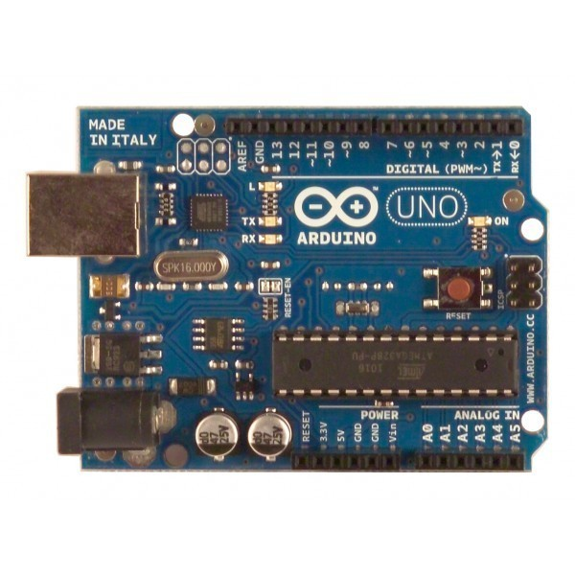
Arduino UNO
$30
Digital Input Ports
USB
DC Power Jack
RESET Button
ISP Programmer
ATMEGA MC
Basic power/ Ground pins
Analog Input Ports

Slide 7
Pins on the Arduino
All pins can be used as Inputs and Outputs.
Pins A0-A5 are used for Analog Reading/Writing
Digital Pins read or write HIGH or LOW.
PWM pins- Pulse Width Modulation Pins

Slide 8
What you need?
Arduino Uno
USB cable
Breadboard
LED’s
Resistors
Other fun stuff like:
Servos, Sensors (IR Distance sensor, Temp, Light etc)

Slide 9
How to get started?
Download the Arduino software
www.Arduino.cc
Download
Find the file and open the Arduino Application
Notes:
It downloads as a zip file so you don’t have to downlaod anything just save the zip file somewhere and then hit extract and you should be ready to run the program.

Slide 10
Components of an Arduino Code Blink on Board LED
1. Define constants (input/ output pins being used)
2. void setup() {….}
Setup things that will run once in your program
3. void loop() {…}
This will run forever until we turn off microcontroller.

Slide 11
Blinking on board LED code:
//Blinking on Board LED
int boardLED = 13;
Void setup() //set BoardLED to output
{
pinMode(boardLED, OUTPUT);
}
Void loop()
{
digitalWrite(boardLED, HIGH);
delay(1000);
digitalWrite(boardLED, LOW);
Delay(1000);
}
Notes:
pinMode takes 2 arguments 1. Specific Pin and 2. whether its an input or output
digitalWrite: set the value of a digital pin

Slide 12
Your first Arduino Project ☺
Logistics:
1. Save the program
2. Make sure you’re program is set up to use your specific Arduino Type.
Tools->Board->Arduino Uno
3. Plug Arduino In:
Start->control Panel-> system and security->system-> device manger->Arduino Uno
Right click arduino Uno and click update driver software-> browse computer for driver software
Navigate to the downloaded arduino folder-> drivers folder
Click okay, next, install anyways, etc etc
If using mac please follow steps on: http://arduino.cc/en/Guide/MacOSX
Notes:
Save project
2. When plugging in the arduino your going to have a problem that the driver software was not successfully installed.
Mac Guide:
http://arduino.cc/en/Guide/MacOSX

Slide 13
Lastly,
Arduino has really good guides online:
http://arduino.cc/en/Guide/HomePage

Slide 14
Session 2

Slide 15
Quick Review
Arduino Program
Global variables
Setup Function
Loop Function
Funtions: (camelCase)
pinMode(int,INPUT or OUTPUT);
delay(int [ms])
digitalWrite(int [pin], HIGH or LOW);

Slide 16
LED’s
Short Pin = Ground (with resistor)
Long Pin = Power

Slide 17
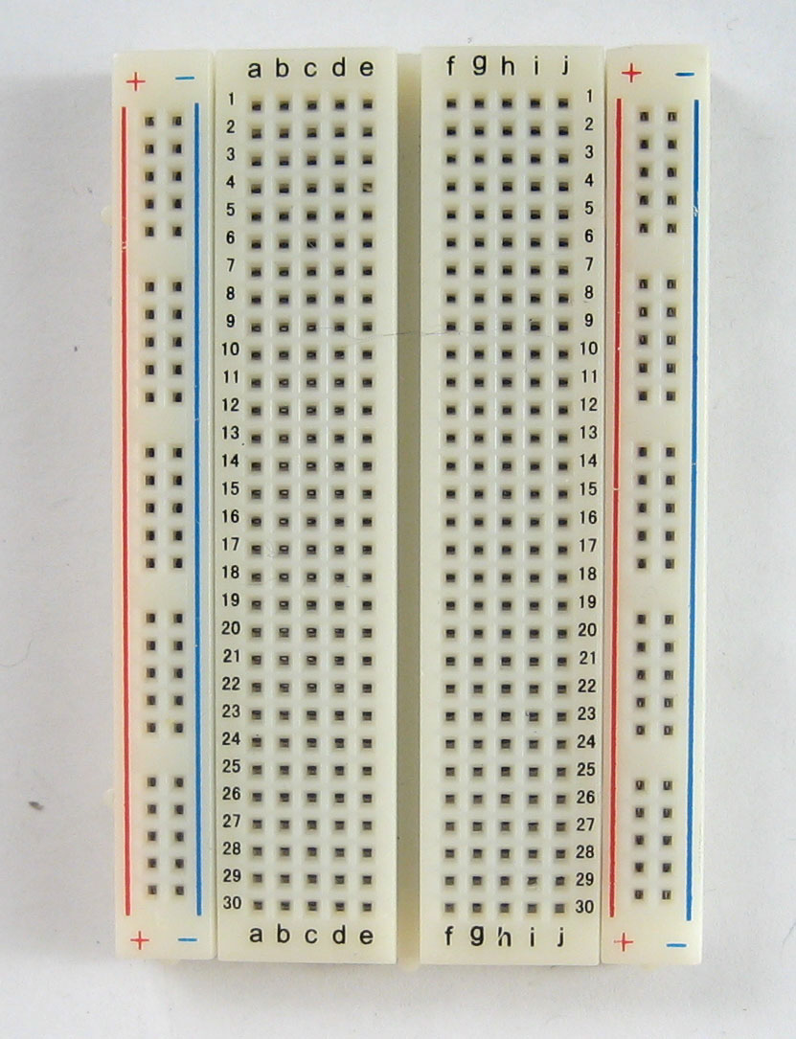
Bread Board
Vertical Rails
Horizontal Rails

Slide 18
EE basics + how they are used with Arduino
Pull-up/ Pull down Resistors
Are key when working with digital inputs.
Voltage Dividers
Basic for analog inputs and most sensors function as voltage dividers
Notes:
R2/R2+R1 where R2 = sensor. Output between R2 and ground.

Slide 19
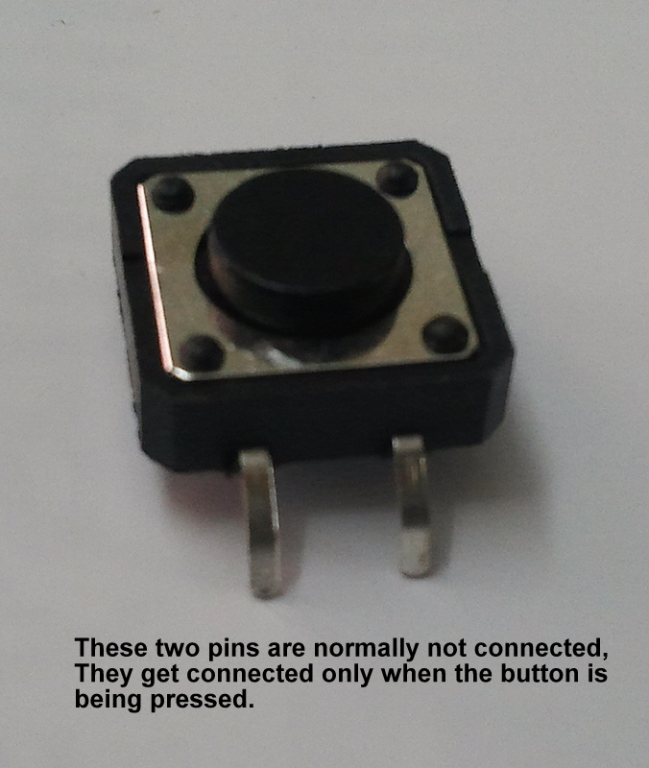
Push Buttons
1. Test Push Button
2. Make push button turn on board LED
3. Make push button turn on LED’s on Bread Board
4. Have some fun

Slide 20
1. Test Push Button
BreadBoard + LED w/ out resistor.
Show Serial Monitor
Add resistor

Slide 21
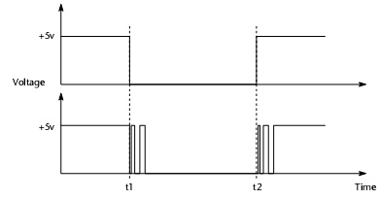
Make push button turn on board LED
Modify the code from Session 1
Account for switch bouncing!

Slide 22
Make push button turn on LED’s on Bread Board
Wire LED’s to breadboard
Turn them on

Slide 23
Have fun ☺
Toggle between states:
All blinking
One blinking at a time
Up and down

Slide 24
Session 3
Analog Inputs
Function using voltage division.

Slide 25
Analog Inputs
A0-A5
Send 10 bit signal to microcontroller
2^10 = 1024
0V = 0
5V = 1023

Slide 26
Typical Analog Inputs
Potentiometer
Sensors (IR, Temp, Light…)

Slide 27
1. Potentiometer to LED’s
Turn on more and more LED’s by turning potentiometer
Ready, set, go!

Slide 28
2- Let’s get crazy
Design a motion detecting security system that turns on a light if it’s dark outside.
Infrared Distance Sensor
LED’s
Light Sensor

Slide 29
Session 4
Interfacing with a computer
Serial Monitor
Processing Program

Slide 30
Serial Monitor:
In setup loop you need to include:
Serial.begin(9600); <-broadband speed
Ways to use the serial monitor:
Debugging

Slide 31
Processing Download
Free download on Processing.org

Slide 32
Lets get to work:
1- Create a device that beeps when it gets near an object (car backing up beeps when it gets near something), and display the distance from the object on the computer screen
Speaker
Infrared Distance sensor
Interface with computer

